Slide 1

Team MMC
TSA Weather Throughput Project
Matan Levy, Cali Stanford, Megan Alicea

Slide 2
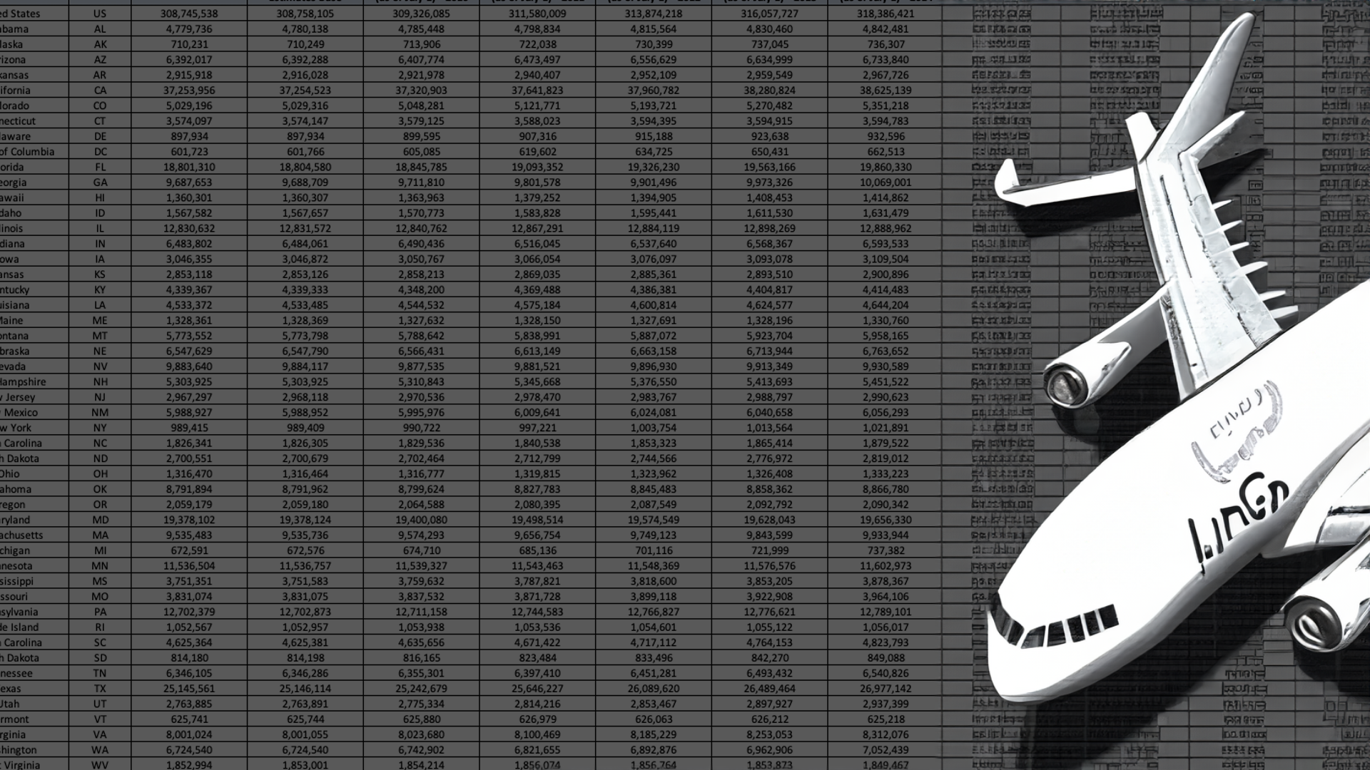
Data Collection
Transforming TSA's FOIA Reading Room public checkpoint data and saving June 2023 U.S. daily weather metrics into a database. We utilized a free weather API called Open Meteo to pull hourly weather data
A database was created and later stored in a data warehouse (Snowflake) that connected to Tableau for analysis and visualizations.
This is a resourceful way to analyze how weather may cause flight cancellations, thus affecting profits airlines additionally make in cargo shipping onboard pedestrian fights.

Slide 3
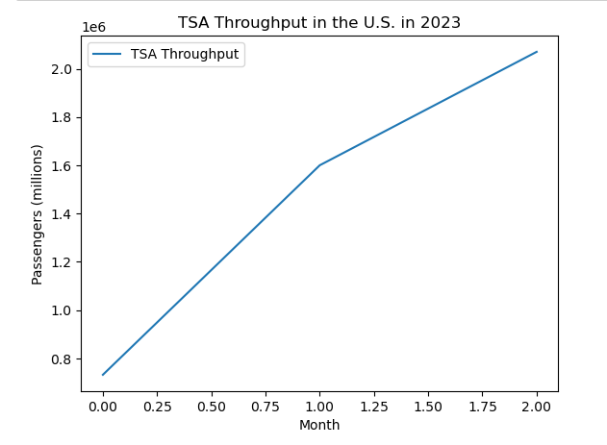
In 1928, one person crossed the Atlantic; in 2018 there were 4.3 billion passenger journeys recorded.
Between January and July of 2023, throughput (the amount of people checking in at airport terminals throughout the U.S.) grew from an average of 1.5M travelers in January to 2.7M in June.
Our analysis was for the month of June.
The busiest day of the year for air travel happens to be in June. For 2023, that was on June 30th.

Slide 4


Started this Project through GitHub

Slide 5
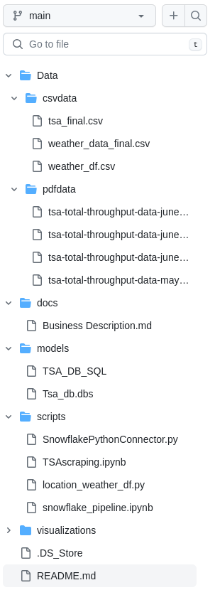
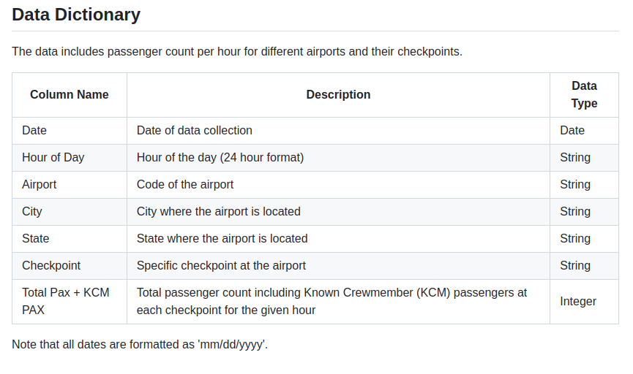
Created ReadMe’s and Folders to build out scripts/repositories in github.
Then, the creation of a data dictionary…

Slide 6
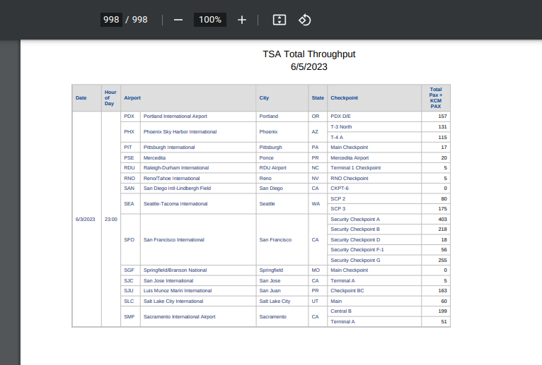
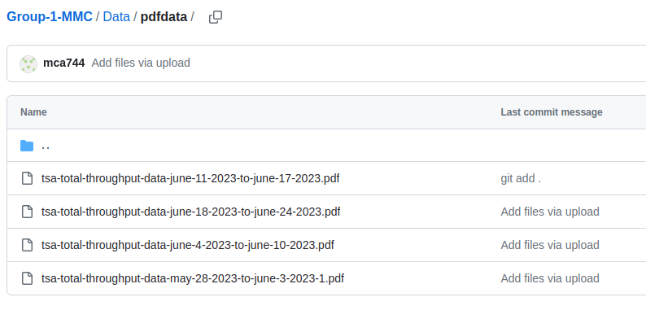
Once four 1,000 page PDF’s were downloaded and stored on GitHub, We used a python algorithm for conversion to save data as CSV’s.
Notes:
bs4: Also known as Beautiful Soup 4, a Python library for web scraping purposes to pull the data out of HTML and XML files.
numpy: A Python library that provides support for large, multi-dimensional arrays and matrices, along with a large collection of high-level mathematical functions to operate on these arrays.
requests: A Python library for making HTTP requests. It abstracts the complexities of making requests behind a beautiful, simple API so that you can focus on interacting with services and consuming data in your application.
azure.storage.blob: A Python package to interact with Azure Blob Storage, which is a scalable object storage for unstructured data.
pymongo: A Python driver for MongoDB, a cross-platform document-oriented database program.
json: A standard library in Python for parsing JSON data.
matplotlib: A plotting library for the Python programming language and its numerical mathematics extension NumPy.
datetime: A standard library in Python for manipulating dates and times.
time: A standard library in Python for time access and conversions.
boto3: Amazon's SDK for Python. It allows Python developers to write software that makes use of services like Amazon S3, Amazon EC2, and others.
io: A standard Python library for handling various types of I/O. In this context, it's used for handling binary I/O (BytesIO).
fuzzywuzzy: A Python library for string matching, it uses Levenshtein Distance to calculate the differences between sequences.
geopy: A Python client for several popular geocoding web services. In your code, Nominatim is being used, which is a free and open-source geocoder from the OpenStreetMap project.
tabula: A Python library for extracting tables from PDF files.
pandas: A Python library providing high-performance, easy-to-use data structures and data analysis tools.
PyPDF2: A Python library to read/write and manipulate PDFs.
camelot: A Python library that makes it easy for anyone to extract tables from PDF files!

Slide 7

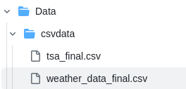
Python script then created - to pull daily weather data, later stored data into the TSA PDF’s.
Used:
-geopy.geocoders
And
Extracted text from PDF’s.
TSA dataframe and Weather data frame both were converted to final CSV files.

Slide 8

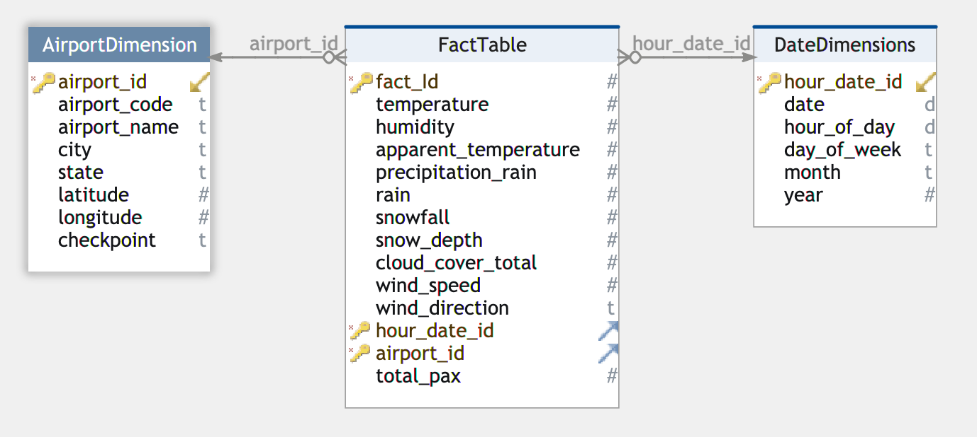
Dimensional Modelling
Star Schema

Slide 9

Snowflake was utilized to create a data warehouse to store
data. Python Script was created to connect Snowflake to CSV through a python pipeline (those of which were saved on github).
-Loaded data.
Dropped duplicate data & null values from CSV.
-Assurance that each table were connected through primary and foreign keys.
-Established Snowflake connection through snowflake.connector.connect.

Slide 10

Lastly, a Driver - written in Python code - connected Snowflake (which stores this database) to Tableau for visualizations.

Slide 11
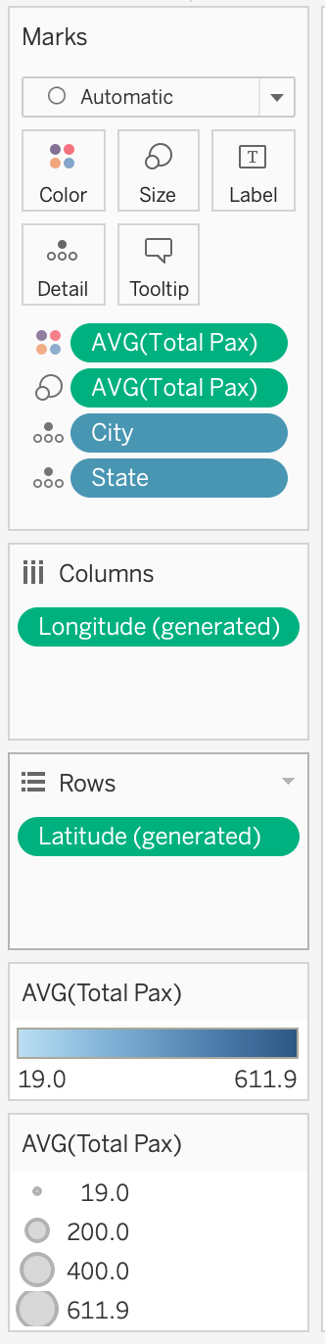
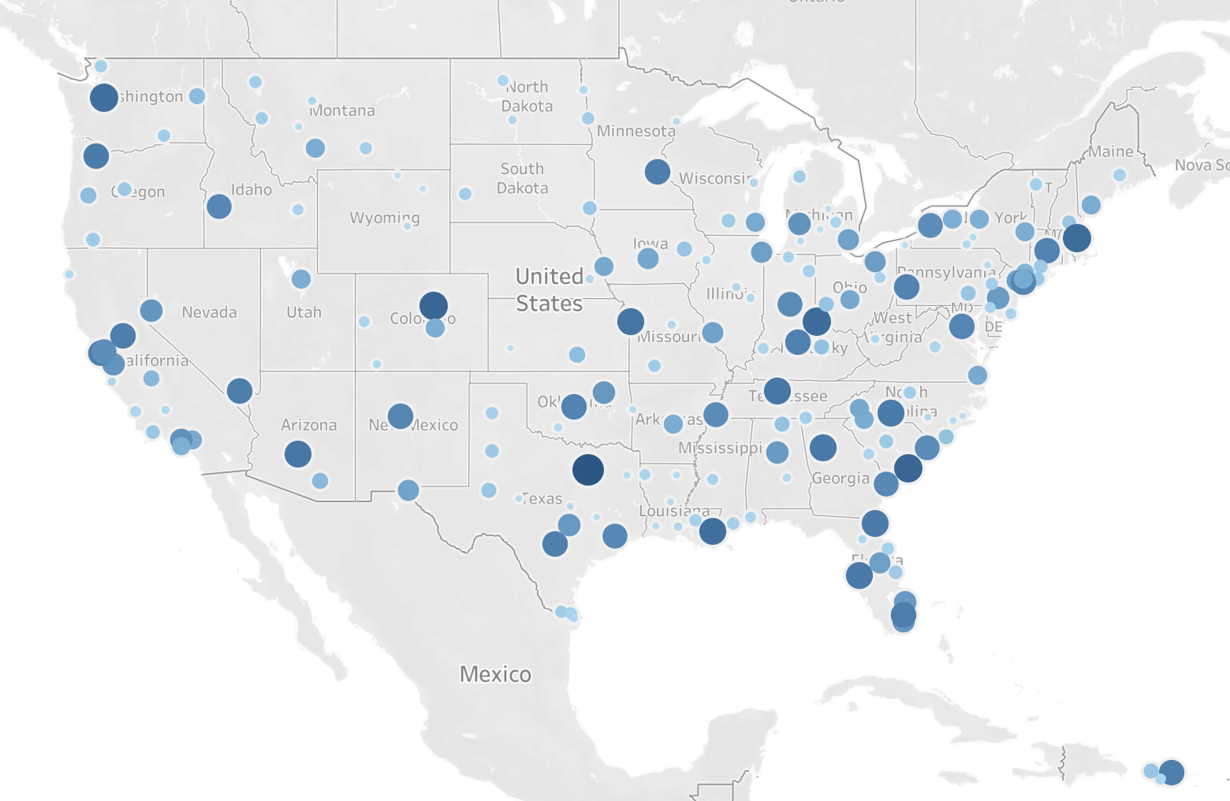
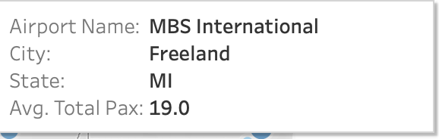
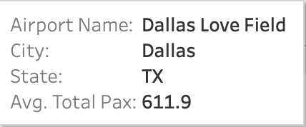
Average PAX Across USA
On Average…
State/Airport with the Maximum PAX:
Dallas, Texas
Dallas Love Field Airport (611.9 PAX)
State/Airport with the Minimum PAX:
Freeland, Minnesota
MBS International Airport (19.0 PAX)

Slide 12
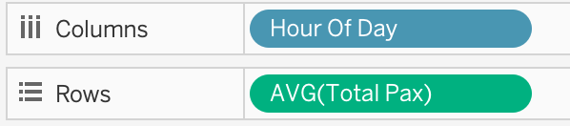
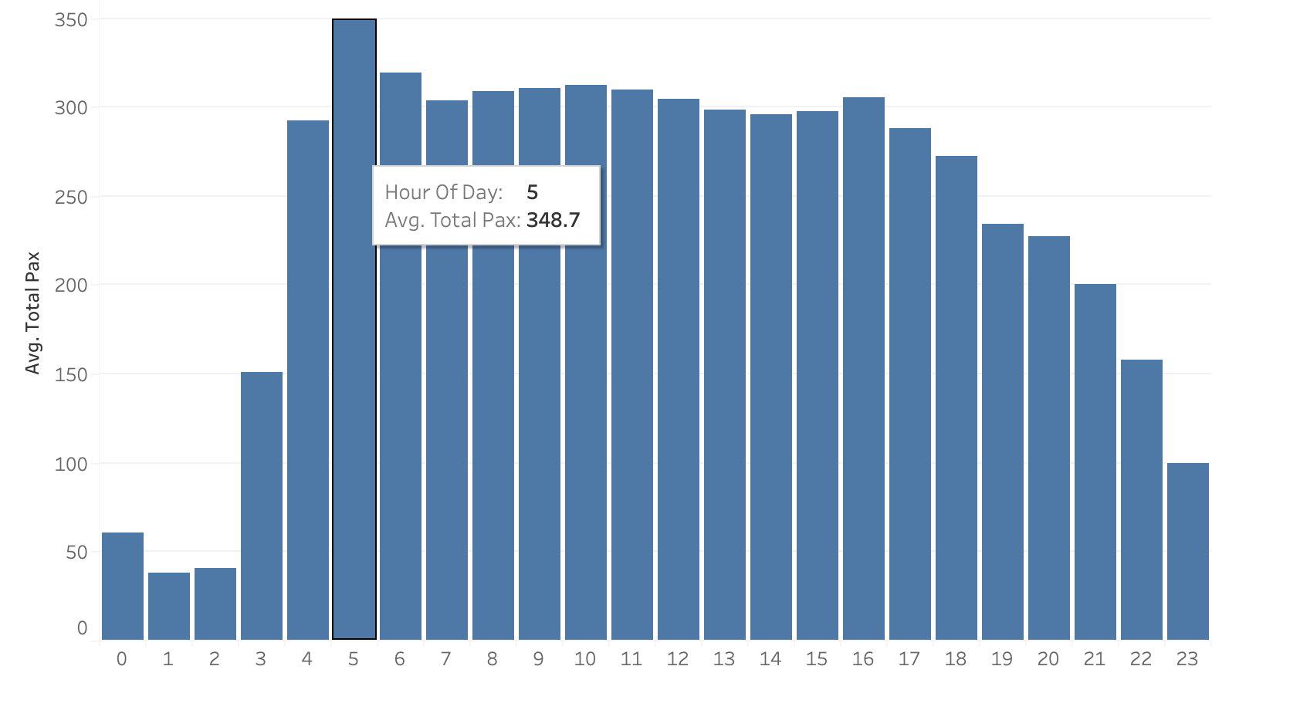
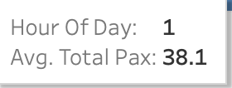
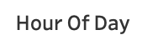
Hourly Average PAX Across the USA
On Average…
The Hour with the Maximum PAX:
5:00AM
The Hour with the Minimum PAX:
1:00AM
Notes:
There are people traveling daily so we focused more granular. What we thought was important had to do with the hours. If you travel and book flights often, you know that traveling and booking tickets at certain hours can be cheaper and most people tend to buy tickets for a certain time to save a quick buck. We feel there is a correlation between this and airport throughput.

Slide 13
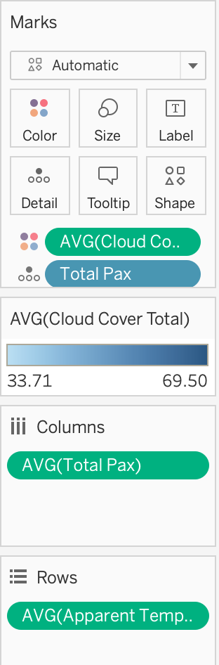
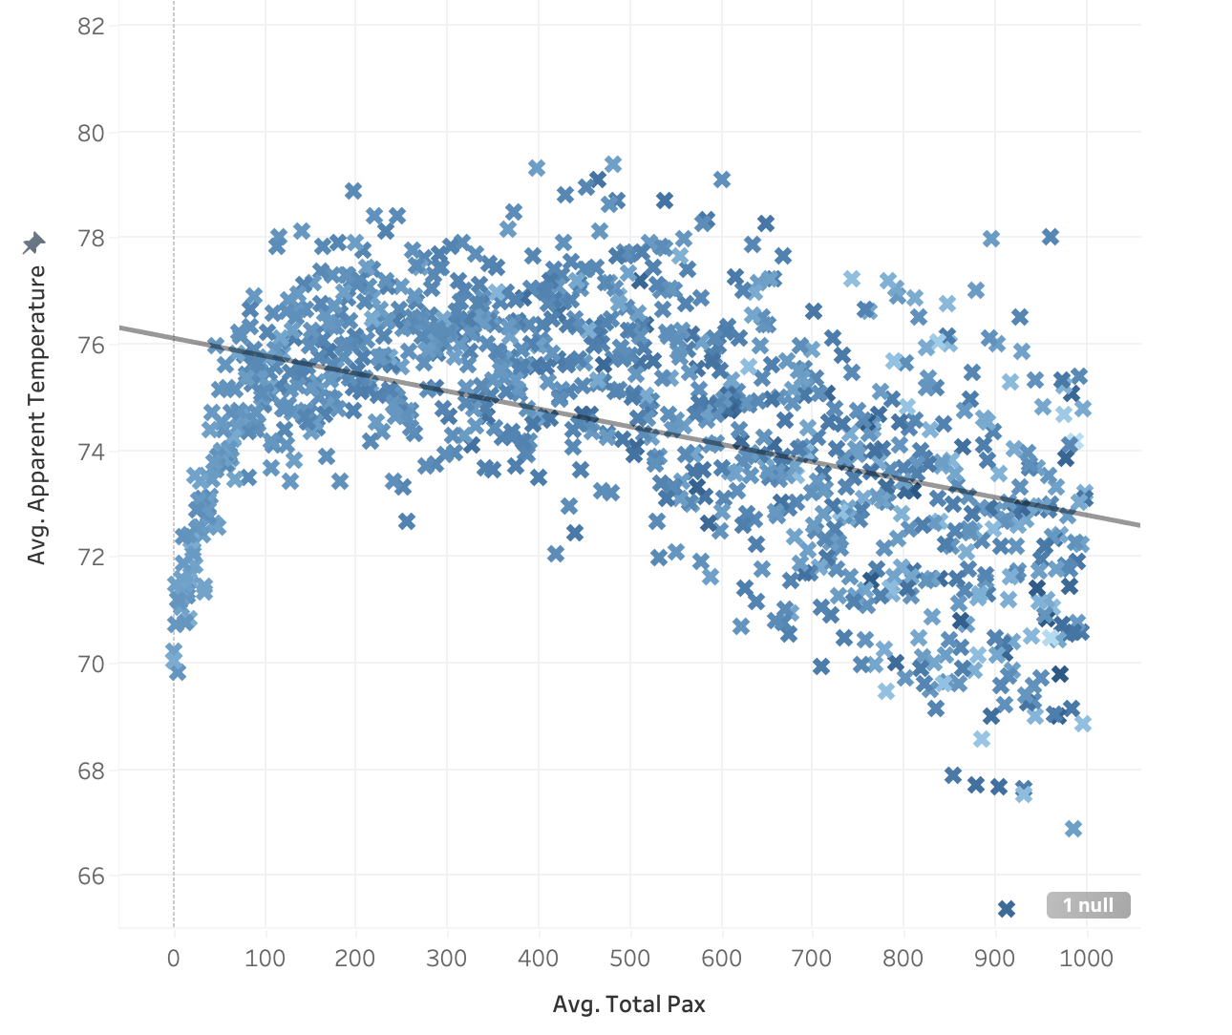
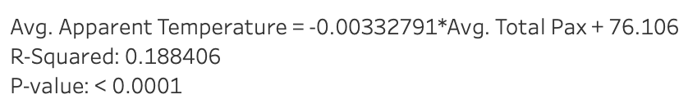
Average PAX vs. Average Apparent Temperature
Notes:
An R of 0.188 indicates a weak positive correlation between two variables. The p-value of <0.00001 is very small, which means that the correlation is statistically significant. This means that there is a very low probability that the correlation is due to chance.
In other words, there is a strong relationship between the two variables, but the relationship is not very strong. For example, this means that as the apparent temperature increases, the total PAX will also tend to increase. However, the increase in the total PAX will not be very large.
In your case, the small p-value suggests a significant relationship, but the R-squared value of 0.188 indicates that the relationship is relatively weak and there is still a substantial amount of unexplained variability in the dependent variable.

Slide 14
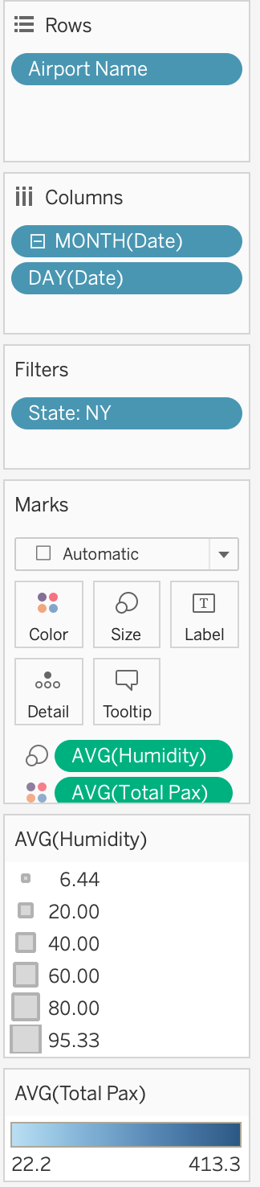
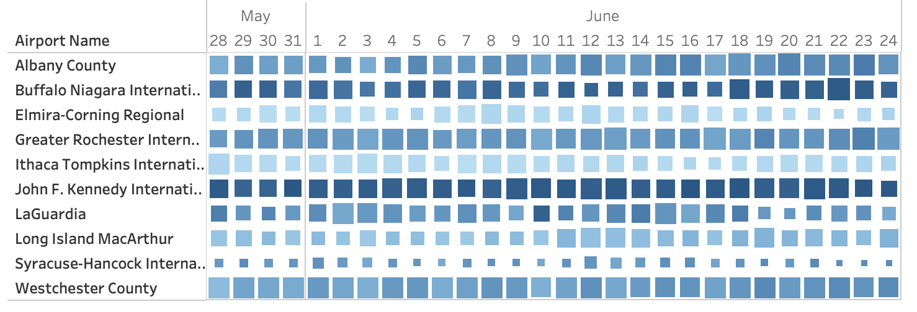
New York PAX vs. Humidity

Slide 15

Future Work
With more resources we’ll be able to add more data (e.g. granular data hourly, daily, monthly, yearly, > 1 year
Maybe instead of the United States we could create a larger warehouse for airports around the world
Regarding weather data we can include things like natural disasters (e.g. hurricanes, wildfires, etc.)
We could include financial data into our model to see if costs change given the factors we have worked with (e.g. costs of travel, tickets at a certain time)

Slide 16
THANK YOU!
Questions? :)

Slide 17
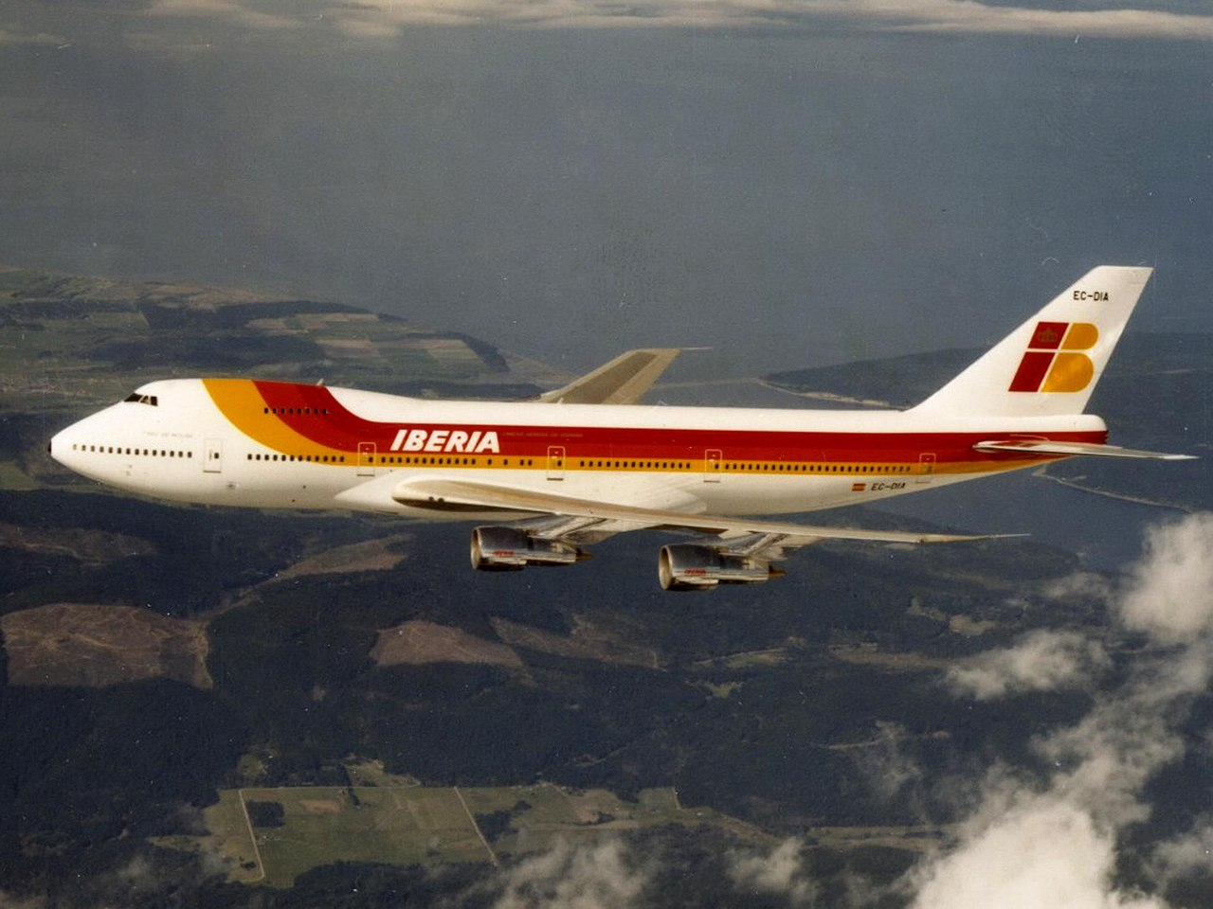
As part of
Professor
Jefferson Bien-Aime’s
Summer 2023
Data Warehousing 4400 Course at Baruch College.

